Slide 1
Agenda
Session I
Distributed DNN training overview
When the network is the bottleneck
SwitchML: In-network aggregation
SwitchML hands-on
Training with SwitchML
SwitchML API
Session II
OmniReduce: Sparse collective communication
OmniReduce hands-on
GRACE: Gradient compression
GRACE hands-on
Implement and run a gradient compression algorithm

Slide 2

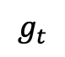
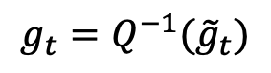
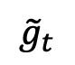
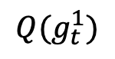
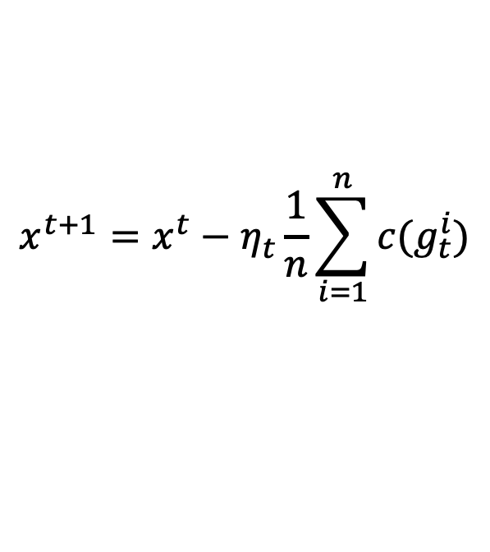
Compressed Communication
OR
PS
AllReduce
Compression at W₁
$$Q(g_{t}^{1})$$
Receive
$${\tilde{g}}_{t}$$
Send
Recover
$$g_{t}=Q^{−1}({\tilde{g}}_{t})$$
$$g_{t}$$
$$g_{t}$$
$$g_{t}$$
W₁
W₂
W₃
W₄
$$x^{t+1}=x^{t}−η_{t}\frac{1}{n}\sum_{i=1}^{n}{c(g_{t}^{i})}$$
Compression
Notes:
to solve the bottleneck -> compressed communication

Slide 3
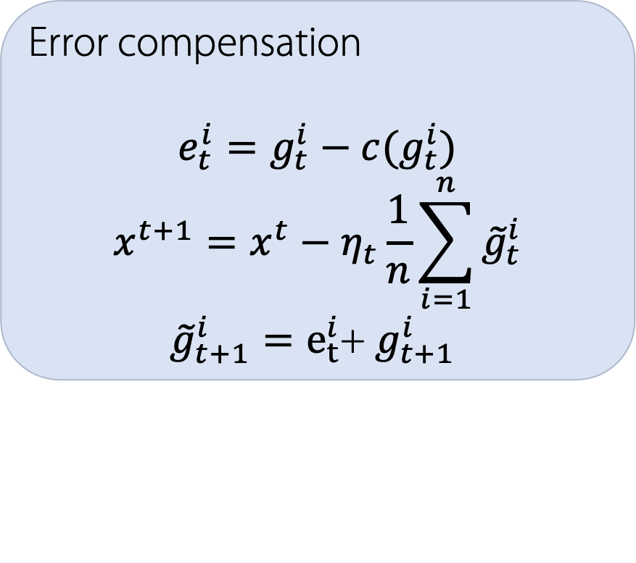
Error Compensation (aka Memory)
Biased Compression
Typically, smaller variance than unbiased
Solution → But, may diverge
Error Compensation
$$E\left(c\left(x\right)\right)≠x$$
Compressor
Error compensation
$$e_{t}^{i}=g_{t}^{i}−c(g_{t}^{i})$$
$$x^{t+1}=x^{t}−η_{t}\frac{1}{n}\sum_{i=1}^{n}{{\tilde{g}}_{t}^{i}}$$
${\tilde{g}}_{t+1}^{i}=e_{t}^{i}$+ $g_{t+1}^{i}$
After compensation
Compensate in next step
Notes:
lossy compression leads to slower convergence -> error compensation

Slide 4
Categories of Compressed Communication
Quantization
Use less bits per element
Sparsification
Eliminate (i.e., set to zero) some elements of the gradient
Transmit only the non-zero elements
Hybrid (Quantization + Sparsification)
Low-rank methods
Decompose gradient into lower-rank components (typically approximate)

Slide 5
8-bit Quantization
Reduce the number of bits of each element in the gradient
Map each float-32 gradient element to float-8
Original gradient
Compressed gradient
float-32
float-32
float-32
…
…
…
…
float-32
float-8
float-8
float-8
…
…
…
…
float-8
Dynamic scheme: exponent 0 to 6 bits
T. Dettmers, “8-Bit Approximations for Parallelism in Deep Learning”, ICLR, 2016.

Slide 6
1-bit Quantization
-1.7 | 2.9 | 10.5 | 11.4 | -23.1 | 0.88 | 1.01 | 0 | 5.51 | -0.98
Original Gradient
τ = 1
0 | 1 | 1 | 1 | 0 | 0 | 1 | 0 | 1 | 0
- | + | + | + | - | + | + | + | + | -
1-bit SGD
sign SGD
Decode
-’s to mean of negative values
+’s to mean of non-negative values
1-bit SGD
F. Seide et al., “1-Bit Stochastic Gradient Descent and Application to Data-Parallel Distributed Training of Speech DNNs”, Interspeech, 2014.
J. Bernstein et al., “signSGD: Compressed Optimisation for Non-Convex Problems”, ICML, 2018.
J. Bernstein et al., “signSGD with Majority Vote is Communication Efficient And Fault Tolerant”, ICLR, 2019.
S. P. Karimireddy et al., “Error Feed-back Fixes Sign SGD and other Gradient Compression Schemes”, ICML, 2019.
signSGD
SIGNUM→signSGD with momentum
EFsignSGD→signSGD with error compensation

Slide 7
Natural Compression - Quantization
Rounds the gradient components to one of the two closest integer powers of 2
Unbiased compression
S. Horvath et al., “Natural Compression for Distributed Deep Learning”, arXiv:1905.10988v2, 2019.

Slide 8
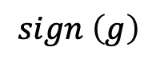
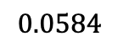
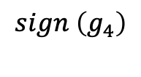
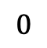
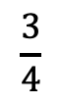
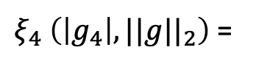
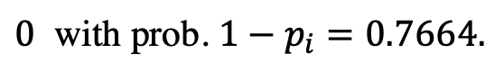
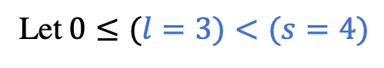
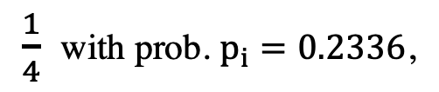
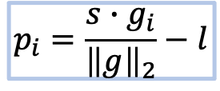
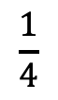
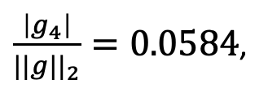
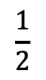
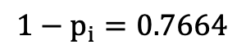
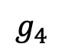
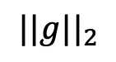
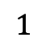
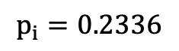
Quantized SGD (QSGD) - Quantization
Let $0≤(l=3)<(s=4)$
$$sign \left(g\right)$$
-3.39
1.78
10.87
-2.22
10.9
1.12
-32.1
12.5
-1 | 1 | 1 | -1 | 1 | 1 | -1 | 1
$$sign \left(g_{4}\right)$$
$$g_{4}$$
$${\tilde{g}}_{4}=Q_{4}\left(g_{4}\right)=− 38.0062∗ξ_{4} \left(\left|g_{4}\right|, ||g||_{2}\right)=0$$
$$||g||_{2}$$
$\frac{1}{4}$ with prob. $p_{i}=0.2336$,
$\frac{\left|g_{4}\right|}{||g||_{2}}=0.0584$,
$$p_{i}=\frac{s{∙g}_{i}}{{\left\|g\right\|}_{2}}−l$$
$ξ_{4} \left(\left|g_{4}\right|, ||g||_{2}\right)$ =
$0$ with prob. $1−p_{i}=0.7664.$
$$p_{i}=0.2336$$
5 codewords
3 bits/word
$$0$$
$$0.0584$$
$$\frac{1}{4}$$
$$\frac{1}{2}$$
$$\frac{3}{4}$$
$$1$$
Original
Gradient g
$${1−p}_{i}=0.7664$$
D. Alistarh et al., “QSGD: Communication-Efficient SGD via Gradient Quantization and Encoding”, NeurIPS, 2017.
J. Wu et al., “Error Compensated Quantized SGD and its Applications to Large-scale Distributed Optimization”, ICML, 2018.

Slide 9
TernGrad - Quantization
Uses {−1, 0, 1} scaled by the infinity norm of the stochastic gradient to obtain the quantized stochastic gradient
Original
gradient
Quantized
gradient
0.49
19.3
-0.78
-0.33
-19.2
3.11
-4.02
0
0
1
1
0
1
1
0
0
-1
-1
0
1
-1
b =
19.3 .
Infinity
norm
Component- wise product
Random from
Bernouli distribution
W. Wen et al., “TernGrad: Ternary Gradients to Reduce Communication in Distributed Deep Learning”, NeurIPS, 2017.

Slide 10
Top-k, Random-k - Sparsification
Top-k
Select k elements with largest absolute values
Biased
Rand-k
Select random k elements
Can be made unbiased by multiplying with (total # of elements) / k
F. Aji et al., “Sparse Communication for Distributed Gradient Descent”, EMNLP-IJCNLP, 2017.
S. U. Stich et al., “Sparsified SGD with Memory”, NeurIPS, 2018.
D. Alistarh et al., “The Convergence of Sparsified Gradient Methods”, NeurIPS, 2018.

Slide 11
Sketched-SGD and Threshold - Sparsification
Sketched-SGD uses count-sketch to select heavy-hitters
Approximates Top-k
N. Ivkin et al., “Communication-efficient Distributed SGD with Sketching”, NeurIPS, 2019.
Threshold: Select the elements whose absolute values are larger than a fixed threshold value τ
0.49
19.3
-0.78
-0.33
-19.2
3.11
-4.02
19.3
-19.2
-4.02
τ = 4
N. Strom, “Scalable Distributed DNN Training using Commodity GPU Cloud Computing”, INTERSPEECH, 2015.
τ may also be adaptive
N. Dryden et al., “Communication Quantization for Data-Parallel Training of Deep Neural Networks”, MLHPC, 2016.

Slide 12
Qsparse SGD - Hybrid
Hybrid method
Combines sparsification with quantization
31.7
40.2
31
40
-7.9
-2.3
31.7
40.2
Quantization
D. Basu et al., “Qsparse-local-SGD: Distributed SGD with Quantization, Sparsification and Local Computations,” in NeurIPS, 2019

Slide 13
SketchML & SKCompress - Hybrid
Up to 12x faster for linear regression
Compression/decompression 5x slower than communication, for DNNs, NVLink
J. Jiang et al., “SketchML: Accelerating Distributed Machine Learning with Data Sketches”, SIGMOD, 2018
J. Jiang et al., “SKCompress: compressing sparse and nonuniform gradient in distributed machine learning”, VLDB-J, 2020

Slide 14
ATOMO, GradiVeQ, PowerSGD, GradZip – Low-rank
ATOMO: minimize variance of stochastic gradient
GradiVeQ: uses SVD
PowerSGD: decompose by power iterations
GradZip: similar to PowerSGD with an additional regularizer
H. Wang et al., “ATOMO: Communication Efficient Learning via Atomic Sparsification”, NeurIPS, 2018.
M. Yu et al. “GradiVeQ: Vector Quantization for Bandwidth-Efficient Gradient Aggregation in Distributed CNN Training”, NeurIPS, 2018.
T. Vogels et al., “PowerSGD: Practical Low-Rank Gradient Compression for Distributed Optimization”, NeurIPS, 2019.
M. Cho et al., “GradZip: Gradient Compression using Alternating Matrix Factorization for Large-scale Deep Learning”, NeurIPS, 2019.

Slide 15
GRACE: Framework and Benchmark for Compressed Communication
Code at https://github.com/sands-lab/grace

Slide 16
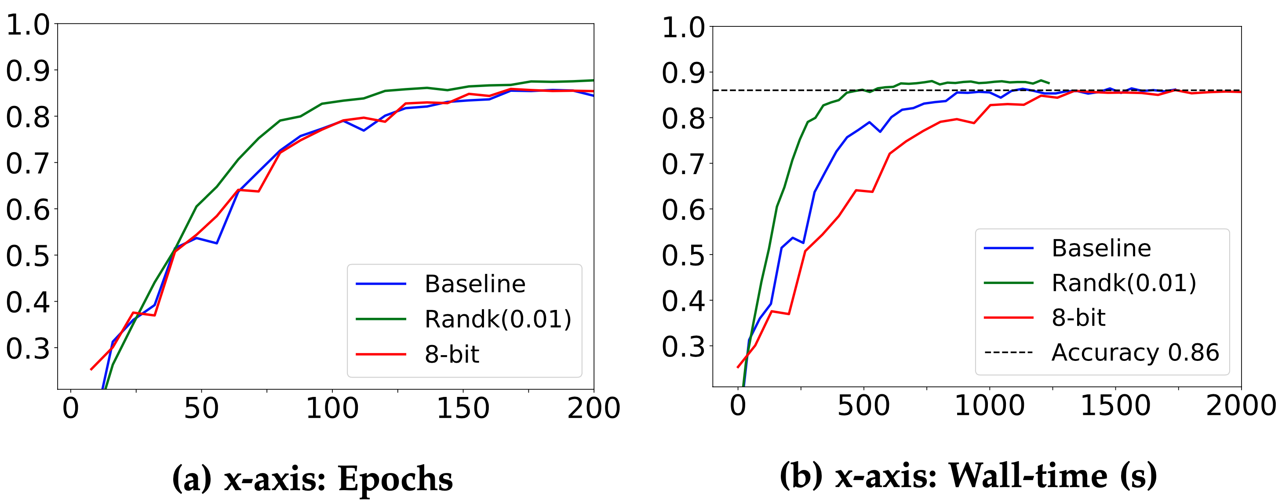
Convergence Speed – Theory vs Practice
Which gradient compressor is better and when?
No standardized evaluation
Unclear how different factors affect the relative performance
DNN architecture, compression level, communication style, …
VGG16
CIFAR-10
TensorFlow
8 workers
25 Gbps network
Top-1 Accuracy

Slide 17
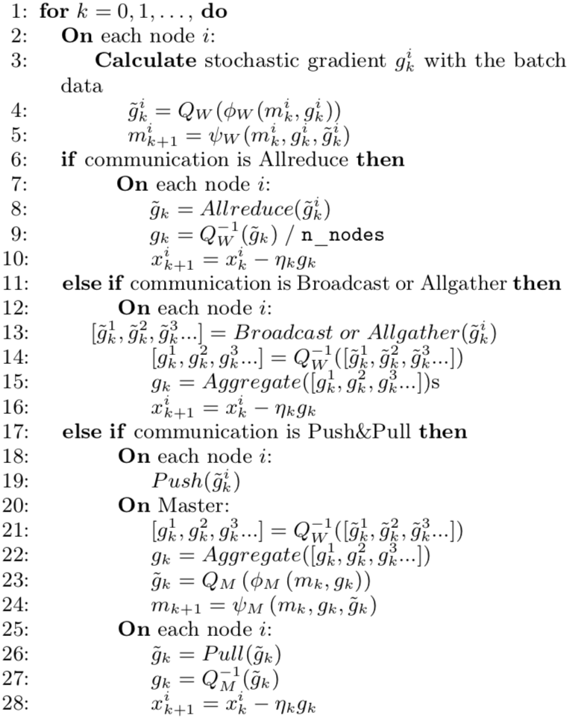
API
WORKER
Compress
Quantize
Sparsify
Pack
useMemory
updateMemory
MASTER
Decompress
deQuantize
deSparsify
unpack
Aggregate
useMemory
updateMemory

Slide 18
GRACE Example
class TopKCompressor(Compressor):
def __init__(self, ratio, mem=NoneMemory(), comm=Allgather()):
super().__init__(mem, comm)
self.ratio = ratio
def compress(self, tensor, name):
shape = tensor.size()
tensor = tensor.flatten()
values, idx = self.sparsify(tensor, self.ratio, torch.topk)
ctx = tensor.numel(), shape
return [values, idx], ctx
def decompress(self, comps, ctx):
numel, shape = ctx
values, idx = comps
t = self.desparsify(numel, values, idx)
return t.view(shape)
Provides a unified API
sparsify/desparsify
quantize/dequantize
Error feedback support
Compensate for errors accumulated due to lossy compression
AllReduce & AllGather communication strategy
PyTorch and TensorFlow support

Slide 19
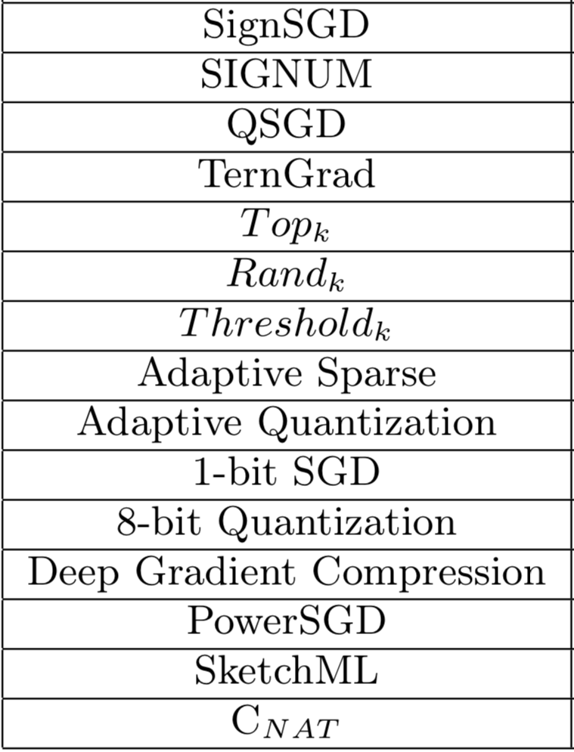
Implementation
Quantization & Sparsification
Optimizers
SGD, AdaGrad, ADAM,…
Popular frameworks
TensorFlow
PyTorch
P2P & Master/Worker
Horovod (OpenMPI, NCCL)
BytePS

Slide 20
ImageNet, Volume, top-5 accuracy
No compression
← Lower is better

Slide 21
ImageNet, Throughput, top-5, 10Gbps
No compression
Higher is better →

Slide 22
NCF benchmark
NCF benchmark example on ML-20m dataset on an 8-worker, 1 x V100 each, 10 GbE network
Results are relative to no compression baseline
Compression not always a win

Slide 23
Summary
Grace is a unified framework and benchmark for compressed communication
Main findings:
No compressor is overall best
Computational overheads of compression are not negligible
DNN architecture, collective libraries, bandwidth all have an impact

Slide 24
Hands-on
Migrate to GRACE from existing training scripts
https://github.com/NVIDIA/DeepLearningExamples.git
Implement custom compressor
Compare performance

